Slide 1
Engaging professional societies in improving the quality of care A view from the ACP
Steven Weinberger, MD, MACP, FRCP, FCCP
Executive Vice President and CEO Emeritus
American College of Physicians
Adjunct Professor of Medicine, Univ. of Pennsylvania
Senior Lecturer on Medicine, Harvard Medical School

Slide 2
Disclosures
I am an employee of the American College of Physicians (ACP)
I have no financial relationships with pharmaceutical companies, device manufacturers, etc.

Slide 3
Outline
Background about the American College of Physicians
Acthar in sarcoidosis: a case study
The role of clinical guideline development
The role of promoting high value care
The importance of sustainable drug pricing

Slide 4
American College of Physicians (ACP) Background
Largest medical specialty society in the world: 148,000 members
Represents the diversity of internal medicine
Ambulatory generalists, hospitalists, subspecialists
Academics, practitioners, educators, researchers, administrators
From solo practice to large groups
Medical students, residents, fellows, practicing clinicians, retired physicians
Domestic and international membership
Welcomes non-physician affiliate members

Slide 5
Our interests at ACP are to:
Further the science of medicine (e.g., Annals of Internal Medicine)
Further the clinical practice of medicine (e.g., clinical standards, guidelines)
Further the education and professional development of physicians (e.g, MKSAP, meetings and courses)
Further the “triple aim” of healthcare (better care, better health of the population, lower per capita costs)
Further the future of medicine (students, residents, fellows)
Further professional satisfaction (e.g., payment reform, practice redesign, addressing burnout)
Develop positions on societal issues that affect health and public health (e.g., firearms violence, climate change)

Slide 6
Sarcoidosis: some background
A multisystem disease of unknown cause, most commonly affecting the respiratory system
Many cases are asymptomatic
Variable natural history; can resolve spontaneously
Decision to treat based on symptoms, organ dysfunction, and trend over time
Oral corticosteroids are the treatment standard
Often improve symptoms and organ involvement
Unclear if alter eventual disease course

Slide 7
Oral corticosteroids and Acthar: some background
Oral corticosteroids
Widely used for a variety of conditions
Cost: $8-12 per month
Acthar (ACTH)
Works by stimulating release of adrenal corticosteroids
FDA-approved in 1952 for multiple indications
Synthetic prednisone developed in 1955 and has replaced use of ACTH
Cost: $35,000 per vial; frequency unclear

Slide 8
Advertisement in CHEST, October 2015

Slide 10
Acthar and drugs like it are at the interface of 3 ACP priorities
Evidence-based medicine
High value, cost-conscious care
X
X
Acthar
X
Sustainable drug pricing

Slide 11
Evidence-based guideline development
Many societies (e.g., ACP, ACCP) now develop evidence-based clinical guidelines that set national standards
Desired composition of guideline committees
Experts in evidence-based medicine
Content experts
Patient representation
Must avoid relevant conflicts of interest

Slide 12
IOM 2011 Standards for Trustworthy Clinical Practice Guidelines
Transparent process (including funding transparency)
Disclosure and management of COIs
Guideline development group composition
Systematic review
Evidence quality and recommendation strength
Articulating recommendations
External review
Updating
IOM. Clinical Practice Guidelines We Can Trust, 2011.

Slide 13
Evidence-based medicine at ACP: historical background
1977 – Medical Necessity Project, funded by BC-BS. Evaluate diagnostic and therapeutic procedures, provide recommendations re value.
1981 – Clinical Efficacy Assessment Project (CEAP)
3 year funding from Hartford Foundation
Oversight from Clinical Efficacy Assessment Subcommittee (CEAS)
Focused on evaluating medical advances – reviewing literature and providing guidance

Slide 14
Current status: Clinical Guidelines Committee
Independent background evidence review, often by Evidence-based Practice Centers (EPC)
Review of data/evidence and recommendations drafted by subpanel of the Clinical Guidelines Committee
Full committee review of recommendations and draft paper
Review and approval by Board of Regents
Submission to Annals of Internal Medicine for formal peer review

Slide 15
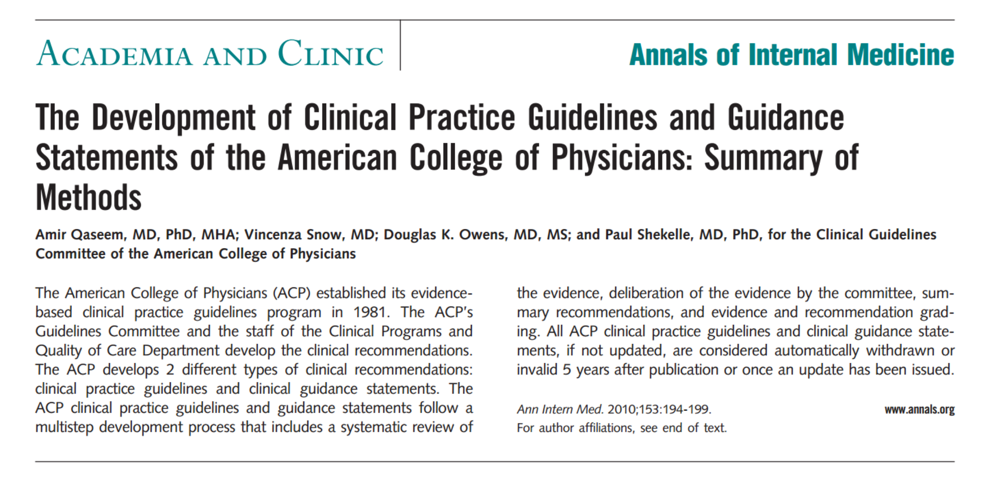

Slide 16
Grading process: Quality of evidence
High quality evidence – obtained from 1 or more well-designed and well-executed randomized, controlled trials (RCTs) that yield consistent and directly applicable results
Moderate quality evidence – obtained from RCTs with important limitations (e.g., small numbers, lack of blinding, unexplained heterogeneity of effect)
Low quality – typically observational studies
Insufficient evidence

Slide 17
Grading of recommendations
Strong recommendation – benefits clearly outweigh risks and burden, or risks and burden clearly outweigh benefits
Weak recommendation – benefits are finely balanced with risks and burden, or uncertainty about magnitude of benefits and risks
Patient preferences may strongly influence the appropriate therapy

Slide 18
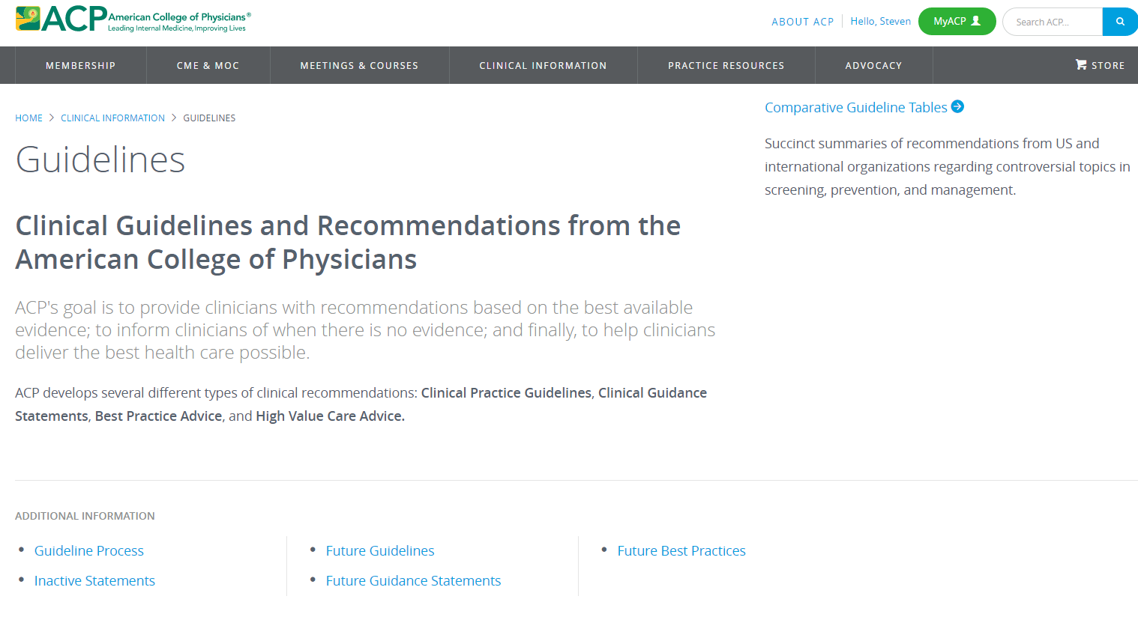

Slide 19
Broadening output of ACP’s Clinical Guidelines Committee
Clinical Guidelines
Clinical Guidance Statements – based on review of existing guidelines by other organizations
Best Practice Advice / High Value Care Advice

Slide 21
High value, cost-conscious care
Costs of healthcare comprise ~17% of US GDP (nearly $3 trillion out of $18 trillion)
Estimate from Institute of Medicine: 30% of healthcare costs are wasted
The healthcare system has a societal responsibility to reduce waste and control costs
Reducing overuse and misuse improves quality
National professional societies can and should play an important role

Slide 22
Mandate to reduce the cost of care
CMS, Office of the Actuary, National Health Statistics Group

Slide 23
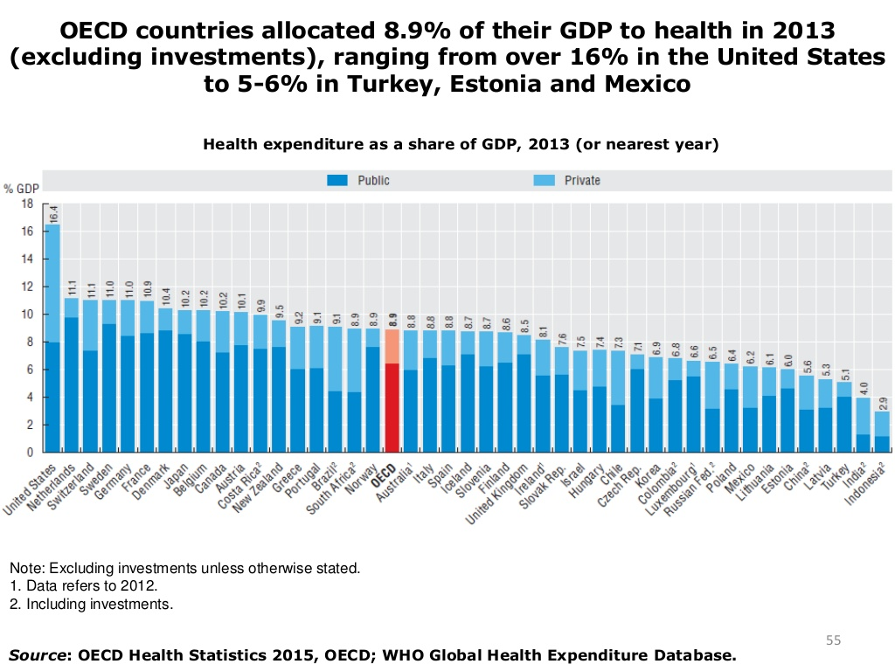
US 16.4%
UK 8.5%

Slide 24
Excess cost domain estimates
IOM. The Healthcare Imperative, 2010.

Slide 25
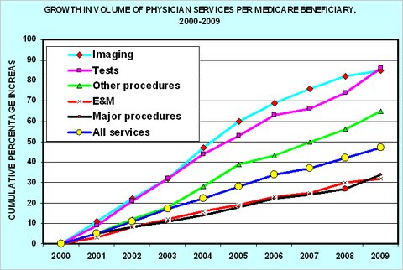
From Reinhardt blog, NY Times, 12/24/2010

Slide 26
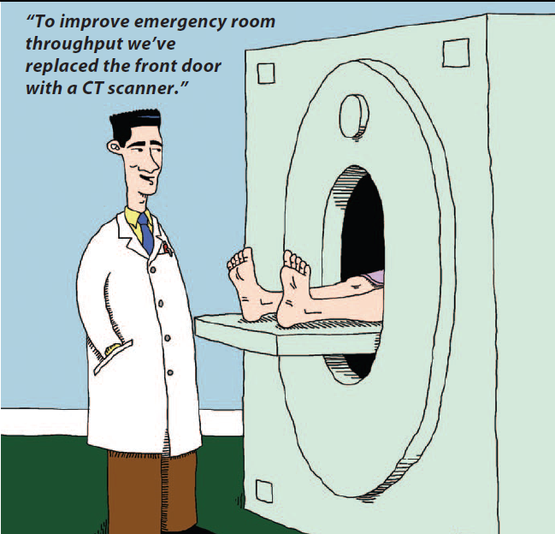
Source: ACP Internist (J.C. Duffy, B. Montgomery)

Slide 27
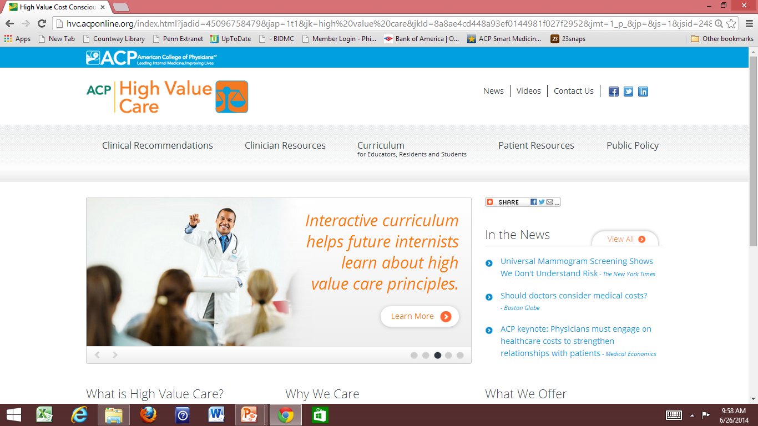
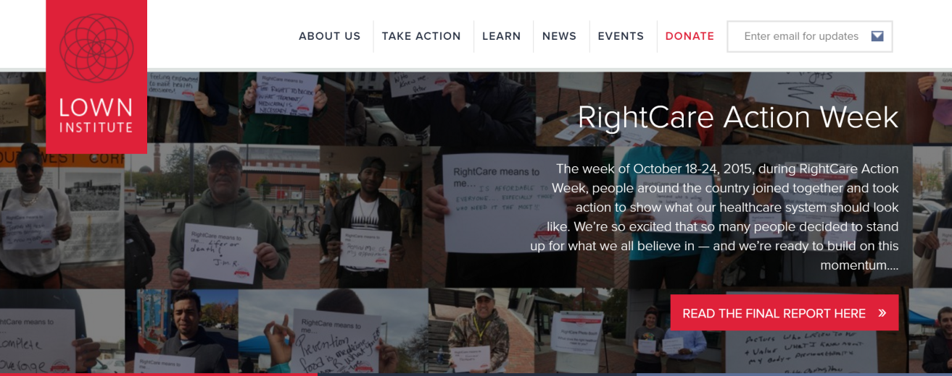

Slide 28
Components of ACP’s High Value Care initiative
Identification of areas of overuse and misuse of care
Establishment of ACP’s High Value Care Task Force
Publication of “best practice / high value care advice ” papers in Annals of Internal Medicine
Education about areas of overuse and misuse of care to several audiences:
Practicing clinicians
Trainees (students, residents, fellows)
Patients

Slide 29
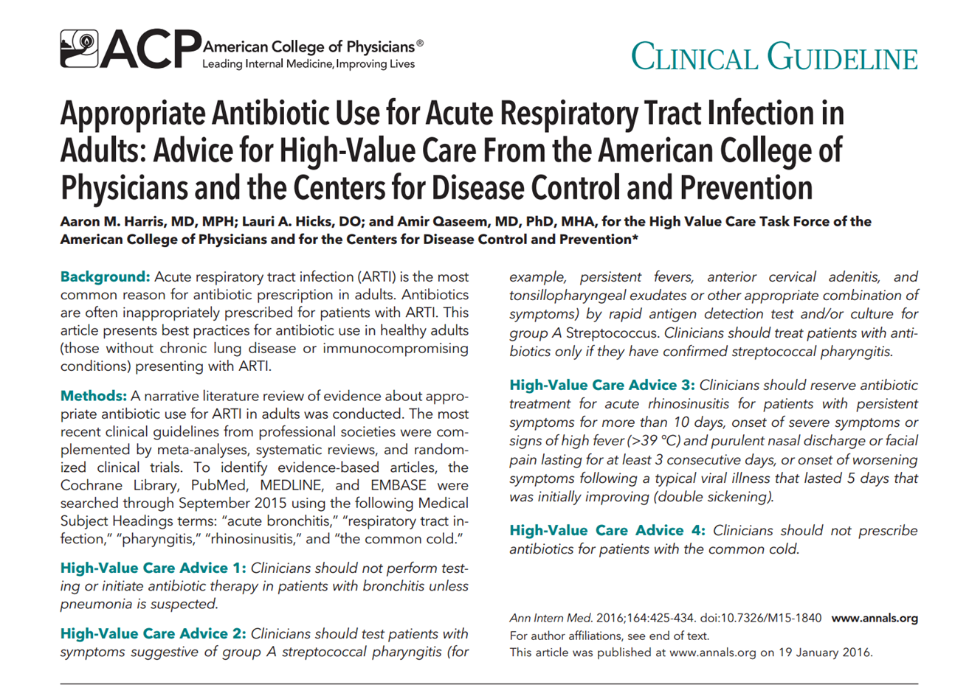

Slide 30
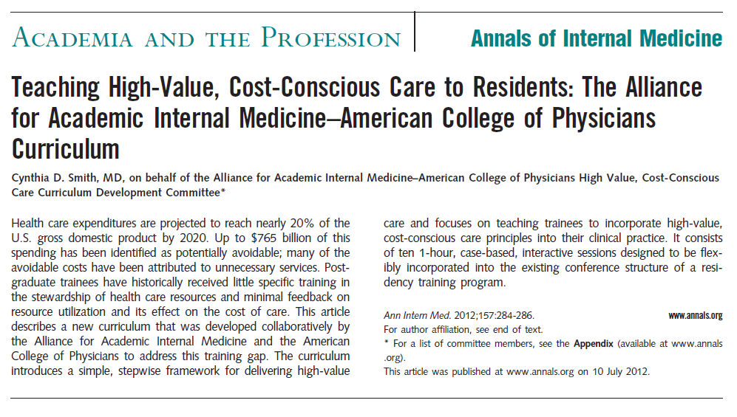
Ann Intern Med. 2012; 157:284-286.

Slide 31
Ann Intern Med. 2011; 155:386-388

Slide 32
ACGME milestone relating to stewardship of resources
Source: http://www.acgme-nas.org/assets/pdf/Milestones/InternalMedicineMilestones.pdf

Slide 33
ACP’s efforts re drug pricing
Areas of concern
High cost of new biologics
Untenable increases in price for generics/established drugs (e.g., colchicine, EpiPen)
Advocacy at federal level, e.g., participation in Campaign for Sustainable Rx. Pricing (www.csrxp.org)
Development of published position statement

Slide 34
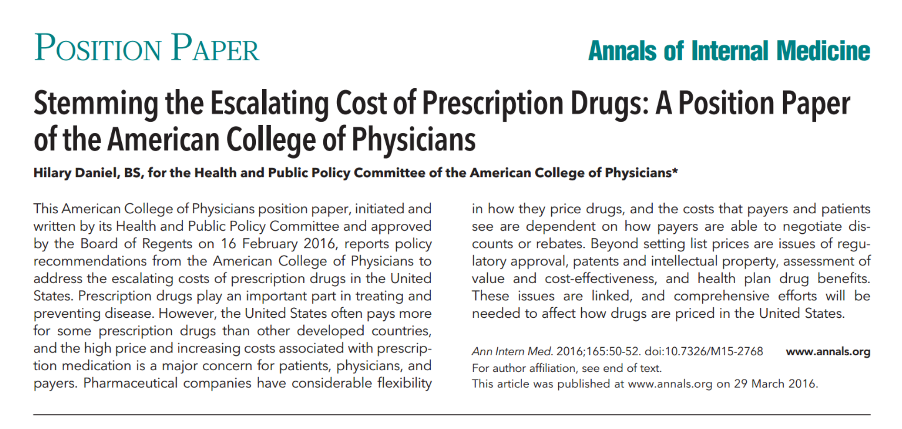
Source: Ann Intern Med. 2016; 165:50-52.

Slide 35
Recommendations from position statement ACP supports:
Transparency in the pricing, cost, and comparative value of all pharmaceutical products
Elimination of restrictions of using quality-adjusted life-years (QALYs) in research funded by the Patient-Centered Outcomes Research Institute (PCORI)
Research into novel approaches to encourage value-based decision making
Ensuring that patient cost-sharing for specialty drugs is not set at a level that imposes a substantial economic burden to patients

Slide 36
ACP supports the following approaches to address the rapidly increasing cost of drugs:
Allow greater flexibility by Medicare and other publicly funded health programs to negotiate volume discounts on prescription drug prices and pursue prescription drug bulk purchasing agreements
Consider legislative or regulatory measures to develop a process to reimport certain drugs manufactured in the US
Establish policies/programs to increase competition for brand-name and generic sole-source drugs

Slide 37
Opportunities for medical professional societies: a summary (ISEA)
Identify evidence-based “best practice” that includes assessment of comparative effectiveness
Use clinical policy/guideline development to set clinical standards
Educate relevant audiences about the clinical standards and about appropriate use
Educate about deceptive/misleading advertising
Advocate for sustainable drug pricing

