Slide 1
NaRCAD 2018 Expert Panel: “Planning and Implementing AD to Address Opioid Prescribing at the Local Level”
Panelists: Teresa Hunter, BS, RS | Public Health Director, Bell County, Kentucky Health Department Victoria Adewumi, MA | Community Liaison, Manchester, New Hampshire Public Health Department Katherine Sawyer, MSW | Director, Integrated Treatment of Co-Occurring Disorders, Network4Health/Mental Health Center of Greater Manchester, New Hampshire Moderator: Aleta Christensen, MPH | Behavioral Scientist, Centers for Disease Control and Prevention
Notes:
Aleta to introduce Panelists’ titles and roles

Slide 2
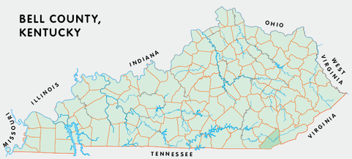
Understanding the Local Context: Bell County, KY
26 states have ≥ 1 vulnerable county.
KY has 54 vulnerable counties, more than any other state.

Slide 3
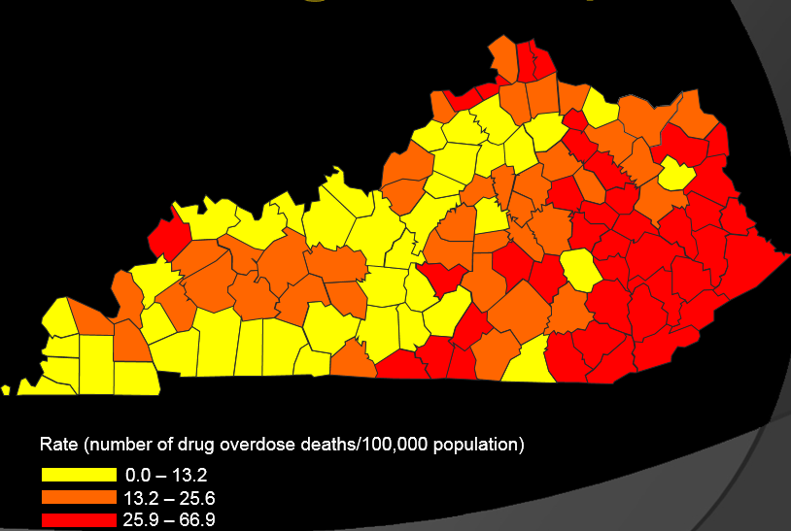
Bell County Overdose Data:
Kentucky Injury Prevention and Research Center

Slide 4
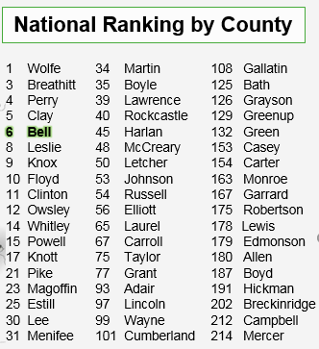
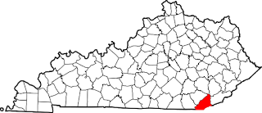
6th Most Vulnerable County in the US
Specific concerns regarding Kentucky counties:
Dense drug user networks
Lack of syringe exchange programs
programs

Slide 5
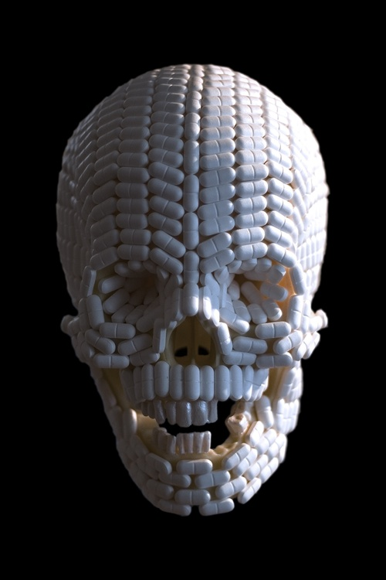
Bell County, Kentucky:
Opioid Prescription Data
From 2010 through 2016,
pharmacies in Bell County filled prescriptions for a total of 30,091,681 doses of opioids…
equivalent to 1,076 pills for every man, woman, and child in Bell County.
Notes:
Cardinal Health – 222/person for Bell Co (http://www.news-herald.com/article/HR/20180220/NEWS/180229963)
McKesson – 351/person (http://www.14news.com/story/37318821/ky-attorney-general-announcing-new-way-to-fight-opioid-epidemic)
AmerisourceBergen = 340/person (http://www.lex18.com/story/37679622/beshear-sues-amerisourcebergen-for-allegedly-supplying-dangerous-levels-of-prescription-painkillers-to-Kentucky)

Slide 6
Notes:
Poll Title: What challenges exist when working in a rural area? https://www.polleverywhere.com/free_text_polls/KNW7YAwSpxhUhCh

Slide 7
Notes:
Poll Title: What are the benefits to working in a rural community? https://www.polleverywhere.com/free_text_polls/Diwn3muJ3CGAtPi

Slide 8
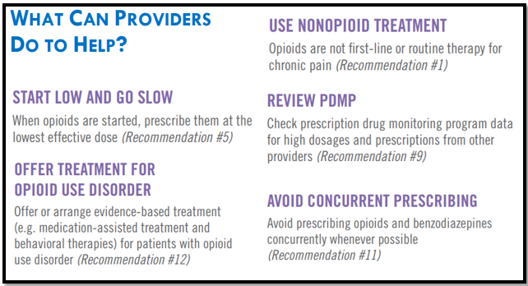
Building the Bell County AD Program
WHO: Building the team: recruiting the right people to provide 1:1 clinician education
HOW: Training with NaRCAD & conducting field visits.
WHAT: What were the campaign’s key messages?

Slide 9
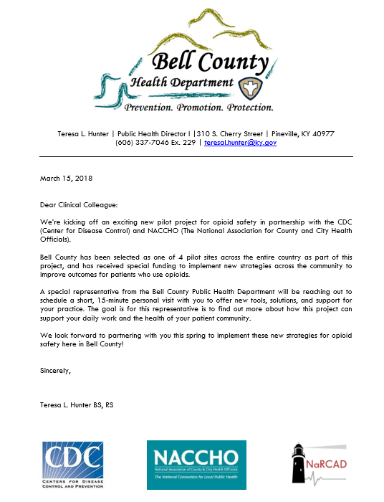
Getting in the Door:
Preparing Primary Care Clinicians
for 1:1 Visits
Leveraging pre-existing relationships
Finding contact data for local clinicians
Persistence in making connections

Slide 10
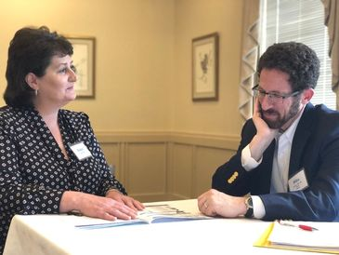
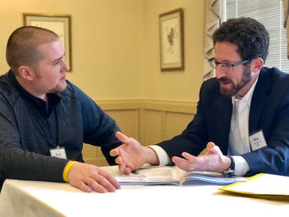
Stories from Bell: Successes and Challenges
Creating new materials
“Drive-by” detailing
Team communication
Close-knit community

Slide 11
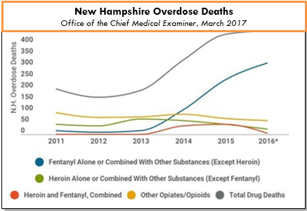
Understanding the Local Context: Manchester, NH

Slide 13
Notes:
Poll Title: What are the barriers to a clinician providing Medication Assisted Treatment (MAT)? https://www.polleverywhere.com/free_text_polls/2Fu33DEJmOFJUIN

Slide 14
Notes:
Poll Title: What supports exist (or should exist) for clinicians who provide MAT? https://www.polleverywhere.com/free_text_polls/pvnOAO2PvquNlv9

Slide 15
Building the Manchester AD Program
WHO: Building the team: how were you recruited? How did you get ready to make 1:1 visits with clinicians?
HOW: Training with NaRCAD, conducting field visits, regular team contact.
WHAT: Same key messages as Bell, but with a strong focus on MAT.

Slide 16
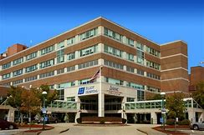
Working within Local Systems
Elliot Hospital
Catholic Medical Center (CMC)

Slide 18
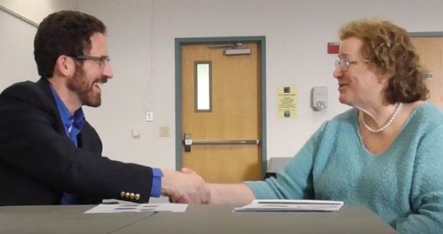
Stories from Manchester: Successes and Challenges
Leveraging strong public health department relationships
Focusing specifically on MAT & OUD Treatment
Working with health systems
Team communication & support

Slide 20
Notes:
Poll Title: Text in your questions for the panelists! https://www.polleverywhere.com/free_text_polls/DSf3tmZrDg78JRW

